Slide 1
Alcohols, Aldehydes, Ketones & Carboxylic Acids

Slide 2
Functional Groups
Functional group: An atom or group of atoms within a molecule that shows a characteristic set of physical and chemical properties.
Functional groups are important for three reason; they are
1. The units by which we divide organic compounds into classes
2. The sites of characteristic chemical reactions
3. The basis for naming organic compounds

Slide 3
Alcohols
Alcohols are compound which contain an -OH (hydroxyl) group attached to saturated carbon atom.
Ethanol may also be written as a condensed structural formula
Alcohols are classified as primary (1°), secondary (2°), or tertiary (3°) depending on the number of carbon atoms bonded to the carbon bearing the -OH group
primary (1° Alcohol)
secondary (2° Alcohol),
Tertiary (3°) Alcohol

Slide 4
Identification Test for Alcohol
Dichromate Test—
Primary alcohols can be oxidized to aldehydes and gives Orange Colored Solution.
Secondary alcohols can be oxidized to ketones gives green color solution,
Tertiary alcohol gives no color change.

Slide 5
Methods of Preparation of Alcohols
1. By Hydration of alkenes: Alkenes react with sulphuric acid and followed by hydrolysis gives alcohols.
2. Hydroboration-Oxidation of Alkenes: Alkenes reacts with diborane and followed by reaction with Alkaline hydrogen peroxide gives an alcohol.

Slide 6
Methods of Preparation of Alcohols
3.Hydrolysis of Alkyl Halides: Alkyl Halides react with aqueous sodium hydroxide to form alcohol
4 . Reduction of Aldehydes or Ketones: Aldehyde on reduction gives primary alcohol and Ketone on reduction
gives secondary alcohol

Slide 7
Reactions of Alcohols
1. Oxidation of Alcohols —
Primary alcohols can be oxidized to aldehydes.
Secondary alcohols can be oxidized to ketones

Slide 8
Reactions of Alcohols
2. Reduction of Alcohols: Alcohols when treated with concentrated HI (Hydro Iodic Acid ) in presence of red Phosphorus it gives alkane.
3. Reaction of alcohol with Thionyl Chloride:
Alcohol when react with Thionyl Chloride it gives alkyl chlorides

Slide 9
Reactions of Alcohols
4 . Dehydration: Dehydration of alcohol in presence of Sulphuric Acid at 170°C gives an Alkene
5) Esterification: Carboxylic acid when treated with an alcohol in acidic medium Ester formation takes place

Slide 10
Aldehydes and Ketones
Contain a carbonyl (C=O) group
When Carbonyl carbon is bonded to one hydrogen & one alkyl group then it is called an Aldehyde
When Carbonyl carbon is bonded to both alkyl group then it is called Ketone

Slide 11
Identification Test for Aldehyde and Ketone
The reaction of 2,4-dinitrophenylhydrazine with an aldehyde or ketone in an acidic solution is a dependable and sensitive test. Carbonyl compounds react with 2,4-dinitrophenylhydrazine
Red or Yellow Colour
Aldehydes and Ketones produce red or yellow precipitate of dinitrophenylhydrazones.

Slide 12
Preparation of Aldehyde & Ketone
1. Oxidation of Alcohols —
Primary alcohols can be oxidized to aldehydes.
Secondary alcohols can be oxidized to ketones

Slide 13
Preparation of Aldehyde & Ketone
2 . Reduction of Acid Chloride:
Acid Chloride on reduction gives corresponding Aldehyde
3. Oxidation of Alkene (ozonolysis): Alkene undergo ozonolysis to give aldehyde

Slide 14
Preparation of Aldehyde & Ketone
4. Wacker Process: Alkene when treated with acidified PdCl₂ and CuCl₂ Aldehyde or ketone is obtained

Slide 15
Reactions of Aldehydes & Ketones
1) Oxidation of Aldehydes: Aldehyde on oxidation gives carboxylic acid
2) Reduction of Aldehydes or Ketones: Aldehyde on reduction gives primary alcohol and Ketone on reduction gives secondary alcohol

Slide 16

Reactions of Aldehydes & Ketones
3) Aldol Condensation:
An extremely important class of carbon-carbon bond forming reaction which involve condensation aldehyde or ketone to give β-hydroxy aldehyde(Aldol product) .
4) Wittig Reaction:
When aldehyde or ketone react with phosphorus ylide it gives an alkene .

Slide 17
Carboxylic Acids
Organic compound which contain a carboxyl (-COOH) group is called as Carboxylic Acid

Slide 18
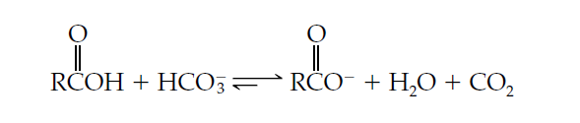
Identification Test of Carboxylic Acid
When an acidic compound dissolves in a sodium bicarbonate solution, carbon dioxide gas is released.
Observation of effervescence confirms that an acid-base reaction did indeed occur.

Slide 19
Method of Preparation of Carboxylic Acid
Oxidation of Alcohol: Alcohol on oxidation in presence of strong oxidizing agent oxidized to aldehyde and then further oxidized to Carboxylic acid
2) Hydrolysis of Nitriles: Nitriles on hydrolysis in presence of acid produces carboxylic acid.

Slide 20
Method of Preparation of Carboxylic Acid
3) Hydrolysis of Ester: Ester on hydrolysis in presence of base produces Carboxylic acid.
4) Caboxylation of alkene( Koch Reaction): Alkene on treatment with Carbon monoxide and Phosphoric Acid in water at 400°C under go carboxylation to give Carboxylic acid . This is also known as Koch reaction.

Slide 21
Reactions of Carboxylic Acids
Reduction of Acid: Carboxylic acid in presence of Lithium Aluminum Hydride get reduced to an alcohol
Reaction of Acid with PCl5 & SOCl2: Carboxylic Acid when reacted with Phosphorus Pentachloride and Thionyl Chloride Acid Chloride is obtained .

Slide 22
Reactions of Carboxylic Acids
3) Formation of Ester: Carboxylic acid when treated with an alcohol in acidic medium Ester formation takes place.
4) Reaction with Amine: Carboxylic acid when reacted with amine it gives an amide

Slide 23
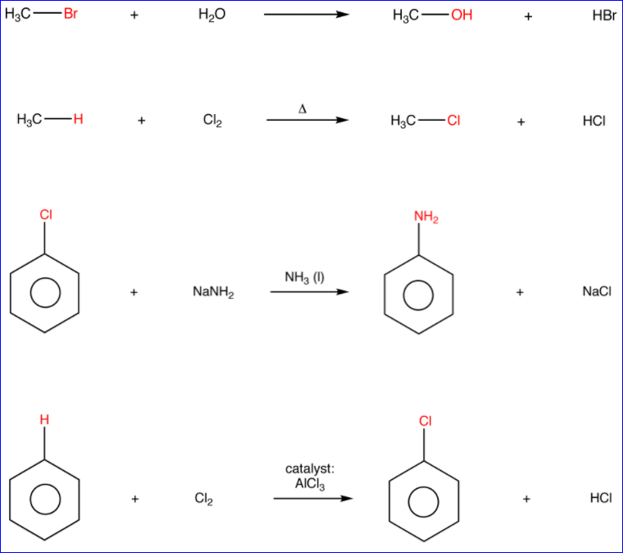
Basic organic reactions (substitution)
A substitution is a reaction in which a ligand in an organic molecule is replaced with another ligand.

Slide 24
Substitution reactions
A substitution reaction is defined as a reaction, in which an atom or a group of atoms attached to a carbon atom is replaced or substituted by another atom or a group of atoms.
The substitution reaction types:
Nucleophilic substitution reaction
Electrophilic substitution reaction

Slide 25
Nucleophilic Substitution reactions
The substitution reactions which are brought about by nucleophilic reagents or nucleophiles (electron rich species) are called nucleophilic substitution reactions.

Slide 26
Nucleophilic Substitution reactions
These reactions are useful class of organic reactions for carbon-carbon and carbon- heteroatom bond formation reactions.
The approach is also widely used for synthetic transformations.
These reactions typically occur on a carbon atom, attached to a leaving group.

Slide 27
Nucleophilic Substitution reactions
Thus, in nucleophilic substitution reactions, the nucleophile is the attacking species which substitutes the leaving group.
The nucleophiles must possess an unshared electron pair.
Nucleophiles could be neutral or negatively charged while a substrate may be neutral or positively charged.
The nucleophiles always attack the substrate at a centre of low electron density or the positive centres in the substrate.

Slide 28
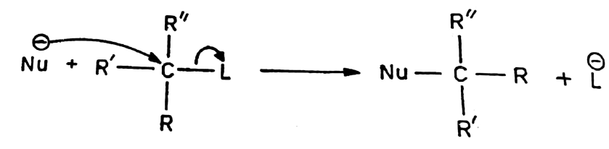
Nucleophilic Substitution reactions
The nucleophilic substitution reaction can be represented as follows:

Slide 29
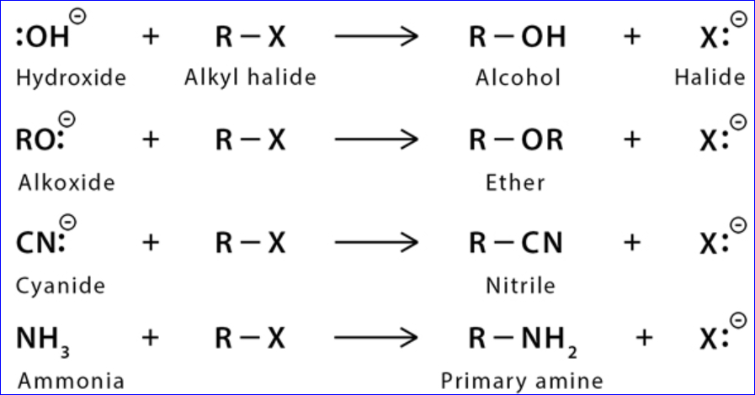
Basic organic reactions (nucleophilic substitution)

Slide 30
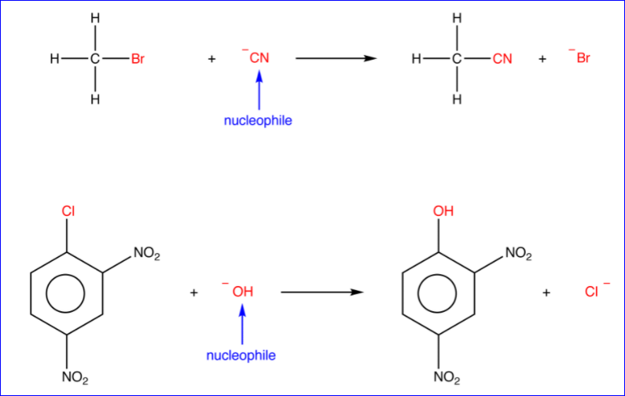
Basic organic reactions (nucleophilic substitution)

Slide 31
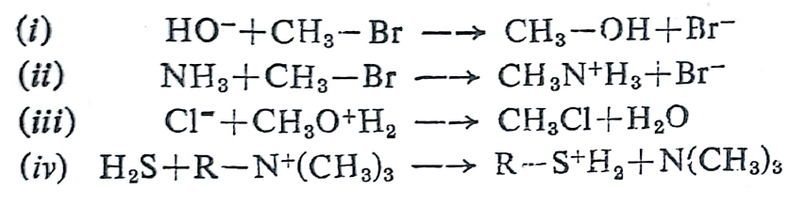
Nucleophilic Substitution reactions
Some more examples of nucleophilic reactions:

Slide 32
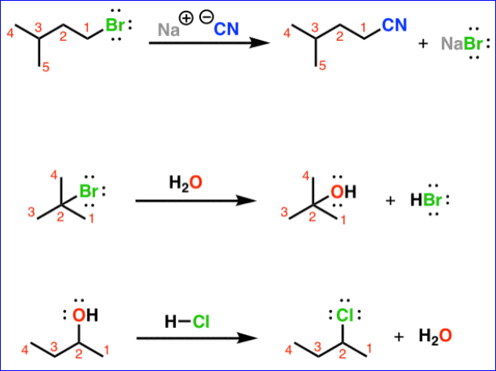
Basic organic reactions (nucleophilic substitution)

Slide 33
Elimination reactions
An elimination reaction is defined as a reaction, in which a molecule loses two atoms or groups, without being replaced by other atoms or groups.
Generally, an elimination reaction involves loss of atoms or groups from adjacent carbon atoms, resulting in the formation of a π-bond between these carbon atoms.
Thus, an elimination reaction is the reverse of an addition reaction.

Slide 34
Basic organic reactions (elimination)
Elimination reactions are possible at positions that are isolated from carbonyls or any other electron-withdrawing groups.
There are two types of elimination reactions based on the mechanism of the reaction:
E1 i.e. Elimination unimolecular
E2 i.e. Elimination bimolecular

Slide 35
Basic organic reactions (elimination)
The elimination reaction can occur in EITHER a single concerted step (E2 mechanism: proton abstraction at C_{α} occurring at the same time as C_{β}-X bond cleavage), OR
In two steps (E1 mechanism: C_{β}-X bond cleavage occurring first to form a carbocation intermediate, which is then 'quenched' by proton abstraction at the alpha-carbon).

Slide 36
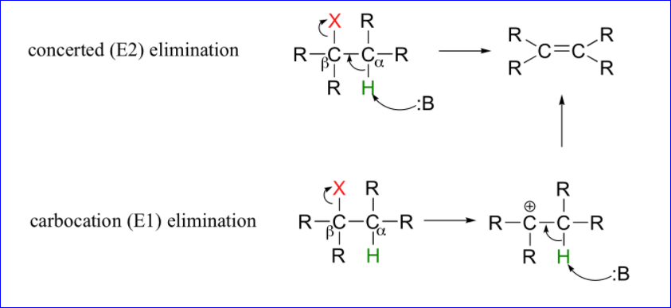
Basic organic reactions (elimination)

Slide 37
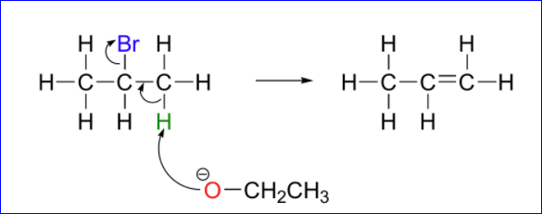
Basic organic reactions (elimination)
E2 elimination reactions in the laboratory are carried out with relatively strong bases, such as alkoxides (deprotonated alcohols).
Ex. 2-bromopropane will react with ethoxide, to give propene.

Slide 38
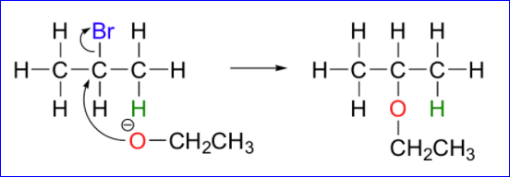
Basic organic reactions (elimination)
Propene is not the only product of this reaction, however - the ethoxide will also to some extent act as a nucleophile in an SN2 reaction.

Slide 39
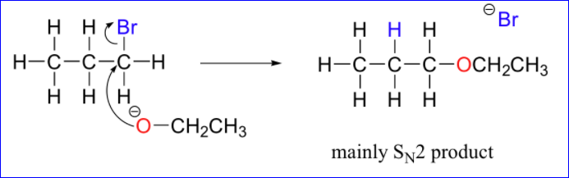
Basic organic reactions (elimination)
Primary carbon electrophiles like 1-bromopropane, for example, are much more likely to undergo substitution (by the SN2 mechanism) than elimination (by the E2 mechanism) – this is because the electrophilic carbon is unhindered and a good target for a nucleophile.

Slide 40
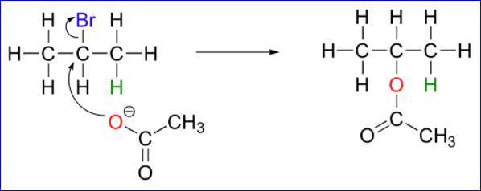
Basic organic reactions (elimination)
SN1 and E1 mechanisms are unlikely with such compounds because of the relative instability of primary carbocations.
The nature of the electron-rich species is also critical. Acetate, for example, is a weak base but a reasonably good nucleophile, and will react with 2-bromopropane mainly as a nucleophile.

Slide 41
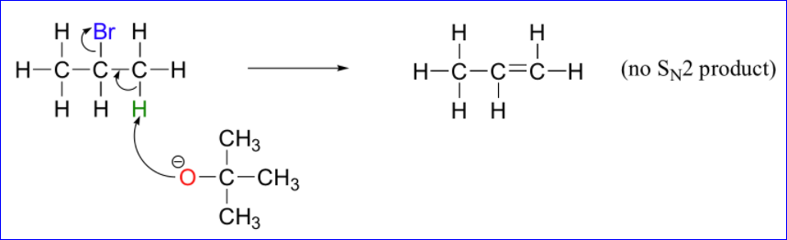
Basic organic reactions (elimination)
In order to direct the reaction towards elimination, a strong hindered base such as tert-butoxide can be used. The bulkiness of tert-butoxide makes it difficult for its oxygen to reach the carbon (meaning tert-butoxide is a bad nucleophile). It is more likely to pluck off a proton, which is much more accessible than the electrophilic carbon)

Slide 42
Basic organic reactions (elimination)
E1 reactions occur by the same kinds of carbocation-favoring conditions that exist for SN1 reactions: a secondary or tertiary substrate, a protic solvent, and a relatively weak base/nucleophile.
In fact, E1 and SN1 reactions generally occur simultaneously, giving a mixture of substitution and elimination products after formation of a common carbocation intermediate.

Slide 43
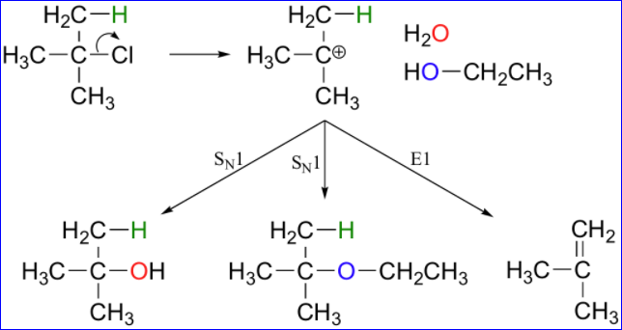
Basic organic reactions (elimination)
For example, when tert-butyl chloride is stirred in a mixture of ethanol and water, a mixture of SN1 products (tert-butyl alcohol and tert-butyl ethyl ether) and E1 product (2-methylpropene) results.

